Slide 1

UNIT - IV Loop Optimization

Slide 2
Loop
A loop is a collection of nodes that ,
Is Strongly connected
Has a unique entry
Most programs run as a loop in the system.
It becomes necessary to optimize the loops in order to save CPU cycles and memory.

Slide 3
Loops can be optimized by the following techniques
Invariant code
Induction analysis
Reduction in Strength
Constant folding and constant propagation

Slide 4
(1) Invariant code / Code Motion
The running time of a program can be improved only if we decrease the length of its loops.
If a computation produces the same value in every loop iteration, move it out of the loop.
An expression can be moved out of the loop if all its operands are invariant in the loop
Constants are loop invariants.

Slide 5
PROD := 0
I :=1
B1
T2 := addr(A) -4
T4 := addr(B) -4
B3
T1 := 4 * I
T3 := T2[T1]
T5 := T4[T1]
T6 := T3 * T5
PROD := PROD + T6
I := I + 1
If I<=20 goto (3)
B2

Slide 6
(2) Induction Variable
This is another important optimization that will actually decrease the total number of instructions as well as speeding up the loop.

Slide 7
PROD := 0
I :=1
B1
T2 := addr(A) -4
T4 := addr(B) -4
B3
T1 := 0
B4
T1 := 4 * I
T3 := T2[T1]
T5 := T4[T1]
T6 := T3 * T5
PROD := PROD + T6
I := I + 1
If I<=20 goto (3)
B2

Slide 8
(3) Reduction in Strength
There are expressions that consume more CPU cycles, time, and memory.
These expressions should be replaced with cheaper expressions without compromising the output of expression.
For example, multiplication (x * 2) is expensive in terms of CPU cycles than (x << 1) and yields the same result.
The replacement of an expensive operator by a cheaper one is termed as reduction in strength.

Slide 9
PROD := 0
I :=1
B1
T2 := addr(A) -4
T4 := addr(B) -4
B3
T1 := 0
B4
T1 := T1 + 4
T3 := T2[T1]
T5 := T4[T1]
T6 := T3 * T5
PROD := PROD + T6
If T1<=76 goto B2
B2

Slide 10
Constant folding and constant propagation
Constant folding:
It is the process of recognizing and evaluating statements with constant expressions (i=22+222+2222 to i=2466), string concatenation (“abc”+”def” to “abcdef”) and expressions with arithmetic identities (x=0; z=x*y[i]+x*2 to x=0; z=0;) at compile time rather than at execution time.

Slide 11
Constant propagation:
It is the process of substituting values of known constants in an expression at compile time.
Eg:
int x=14;
int y=7+x/2;
return y*(28/x+2);
Applying constant folding and constant propagation,
int x=14;
int y=14;
return 56;

Slide 12
Peephole Optimization
• Optimizing a small portion of the code.
• These methods can be applied on intermediate codes as well as on target codes.
• A bunch of statements is analyzed and are checked for the following possible optimization

Slide 13
(1) Redundant instruction elimination
At compilation level, the compiler searches for instructions redundant in nature.
Multiple loading and storing of instructions may carry the same meaning even if some of them are removed.
For example:
MOV x, R0
MOV R0, R1
First instruction can be rewritten as
MOV x,R1

Slide 14
(2) Unreachable Code
It is the removal of unreachable instructions.
An unlabeled instruction immediately following an unconditional jump may be removed.
This operation can be repeated to eliminate a sequence of instructions.
For example, for debugging purposes, a large program may have within it certain segments that are executed only if a variable debug is 1.

Slide 15
In the intermediate representations the if-statement may be translated as:
If debug =1 goto L1
goto L2
L1: print debugging information
L2:
One obvious peephole optimization is to eliminate jumps over jumps.
#define debug 0
….
If ( debug )
{
Print debugging information
}
If debug ≠1 goto L2
Print debugging information
L2 :

Slide 16
(3) Flow of control optimization
The unnecessary jumps can be eliminated in either the intermediate code or the target code by the following types of peephole optimizations.
We can replace the jump sequence
goto L1
….
L1: gotoL2
L2:
by the sequence goto L2
L1: goto L2
if a < b goto L1
….
L1: goto L2
L2:
can be replaced by
If a < b goto L2
L2:

Slide 17
(4) Algebraic Simplification
There is no end to the amount of algebraic simplification that can be attempted through peephole optimization.
Only a few algebraic identities occur frequently enough that it is worth considering implementing them. For example, statements such as
x := x+0
or
x := x * 1
are often produced by straightforward intermediate code-generation algorithms, and they can be eliminated easily through peephole optimization.

Slide 18
(5) Reduction in Strength
Reduction in strength replaces expensive operations by equivalent cheaper ones on the target machine. Certain machine instructions are considerably cheaper than others and can often be used as special cases of more expensive operators.
For example, x² is invariably cheaper to implement as x*x than as a call to an exponentiation routine.

Slide 19
Fixed-point multiplication or division by a power of two is cheaper to implement as a shift.
Floating-point division by a constant can be implemented as multiplication by a constant, which may be cheaper.
X2 → X*X

Slide 20
(6) Use of Machine Idioms
The target machine may have hardware instructions to implement certain specific operations efficiently.
For example, some machines have auto-increment and auto-decrement addressing modes.
These add or subtract one from an operand before or after using its value.

Slide 21
The use of these modes greatly improves the quality of code when pushing or popping a stack, as in parameter passing.
These modes can also be used in code for statements like i : =i+1.
i:=i+1 → i++
i:=i-1 → i- -

Slide 22
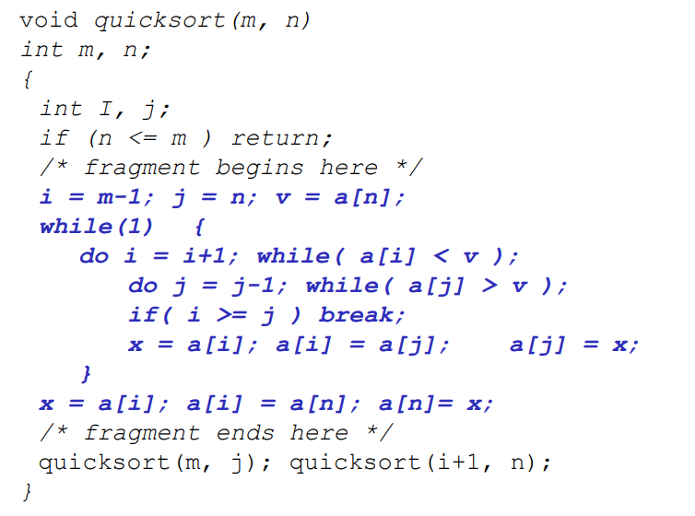
QUICK SORT

Slide 23
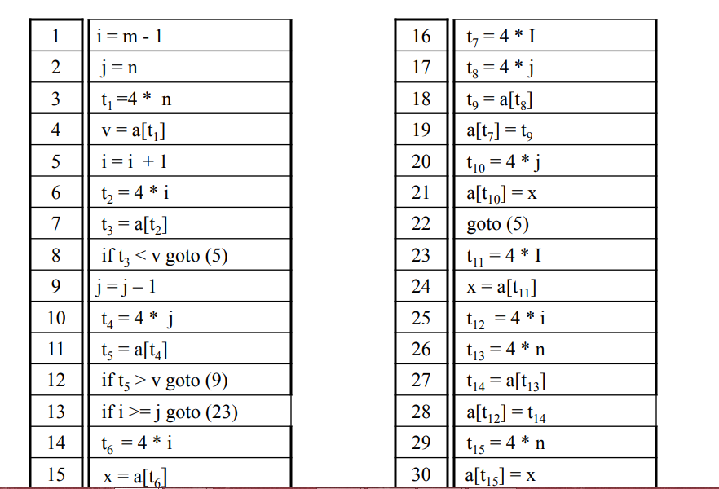

Slide 24
To be done
Identify the basic blocks of the 3 address code of the previous slide
Build the control flow diagram
Apply as many optimizations you can to that code, pointing out which one you apply, and in which order

Slide 25
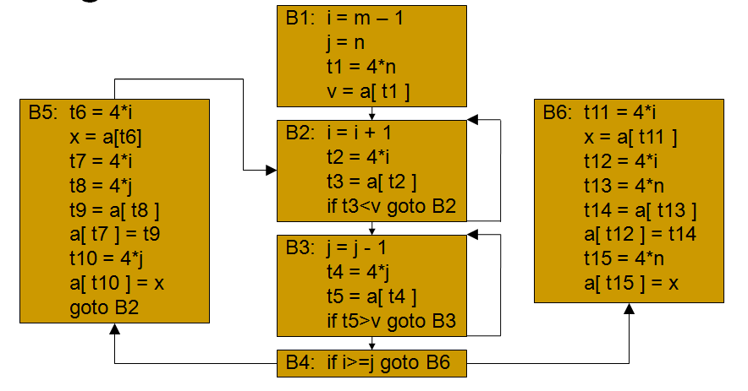
Flow Graph

Slide 26
Common Sub-expression Elimination
An occurrence of an expression E is called a common subexpression if E was previously computed and the values of the variables in E have not changed since the previous computation.
Avoid recomputing E if can be used its previously computed value; that is, the variable x to which the previous computation of E was assigned has not changed in the interim.

Slide 27
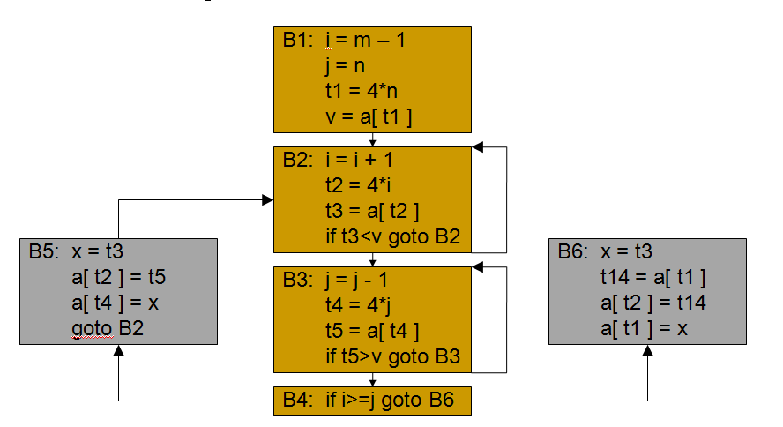

Slide 28
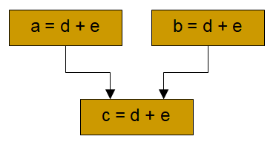
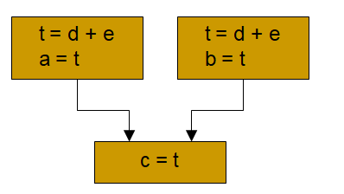
Copy Propagation
This optimization concerns assignments of the form u = v called copy statements.
The idea behind the copy-propagation transformation is to use v for u, wherever possible after the copy statement u = v.
Copy propagation work example

Slide 29
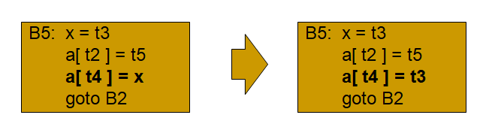
Copy Propagation
The assignment x = t3 in block B5 is a copy.
Here is the result of copy propagation applied to B5.
This change may not appear to be an improvement, but it gives the opportunity to eliminate the assignment to x.
One advantage of copy propagation is that it often turns the copy statement into dead code.

Slide 30
Dead-code Elimination
Code that is unreachable or that does not affect the program (e.g. dead stores) can be eliminated.
In the example below, the value assigned to i is never used, and the dead store can be eliminated.
The first assignment to global is dead, and the third assignment to global is unreachable; both can be eliminated.
int global;
void f ()
{
int i;
i = 1; /* dead store */
global = 1; /* dead store */ global = 2;
return;
global = 3; /* unreachable */
}
int global;
void f ()
{
global = 2;
return;
}
Before
After

Slide 31
Flow Graph after Induction Variable Elimination/Reduction in Strength
B1: i = m – 1
j = n
t1 = 4*n
v = a[ t1 ]
t2 = 4*I
t4 = 4*j
B2: t2 = t2 + 4
t3 = a[ t2 ]
if t3<v goto B2
B5: a[ t7 ] = t5
a[ t10 ] = t3
goto B2
B6: t14 = a[ t1 ]
a[ t2 ] = t14
a[ t1 ] = t3
B3: t4 = t4 - 4
t5 = a[ t4 ]
if t5>v goto B3
B4: if t2>t4 goto B6

Slide 32
Directed Acyclic Graph (DAG)
DAG is a tool that depicts the structure of basic blocks, helps to see the flow of values flowing among the basic blocks, and offers optimization too.
DAG provides easy transformation on basic blocks.
DAG can be understood here:
Leaf nodes represent identifiers, names or constants.
Interior nodes represent operators.
Interior nodes also represent the results of expressions or the identifiers/name where the values are to be stored or assigned.

Slide 33
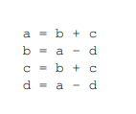
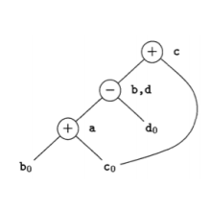

Slide 34
Algorithm for construction of DAG
Input :
A basic block
Output :
A DAG with the following information
1. A label for each node
2. For each node, a list of identifiers
Method :
Create nodes with one or two child with left and right children. There is one function NODE (identifier) that returns the most recently created node associated with the identifier.

Slide 35
The three address statements may be in any of the three cases.
(i) A := B op C
(ii) A := op B
(iii) A := B
Step 1:
If NODE (B) is undefined, then create a leaf label B and let NODE(B) be the node.
If NODE (C) is undefined, then create a leaf label B and let NODE(C) be the node.
[If B and C nodes are not present already, create the nodes and name it B and C]

Slide 36
Step 2 :
In case (i) determine if there is a node labeled operator (op) whose left child is NODE(B) and whose right child is NODE(C). If not, create such a node.
In case (ii) determine if there is a node labeled operator (op) whose left child is NODE(B). If not, create such a node.
In case (iii), let ‘n’ be the node(B)
Step 3:
Append A to the list of attached identifiers for the node found in step 2

Slide 37
Example: Construct the DAG for the following three-address code
S1 := 4 * I
S2 := addr(A) – 4
S3 := S2 [S1]
S4 := 4 * I
S5 := addr(B) – 4
S6 := S5[S4]
S7 := S3*S6
S8 := PROD + S7
PROD :=S8
S9 := I + 1
I:=S9
If I<=20 goto (1)

Slide 38
S1 :=4*I
S1
n3
*
n1
n2
4
I
S2 := addr(A) – 4
S2
S1
n5
n3
-
*
n4
n1
n2
Addr(A)
4
I

Slide 39
S3 := S2 [S1]
n2
S3
[ ]
S2
S1
n3
n3
-
*
n4
n2
n2
Addr(A)
4
I

Slide 40
S4 := 4 * I
n6
S3
[ ]
S2
S1,S4
n5
n3
-
*
n4
n1
n2
Addr(A)
4
I

Slide 41
S5 := addr(B) – 4
n6
S3
[ ]
S5
S2
S1,S4
n5
n3
n8
-
*
-
n4
n1
n2
n7
Addr(A)
4
I
Addr(B)

Slide 42
S6 := S5[S4]
S6
n9
n6
[ ]
S3
[ ]
S5
S2
S1,S4
n5
n3
n8
-
*
-
n4
n1
n2
n7
Addr(A)
4
I
Addr(B)

Slide 43
S7 := S3*S6
S7
n10
S6
S6
*
n9
n6
[ ]
S3
[ ]
S5
S2
S1,S4
n5
n3
n8
-
*
-
n4
n1
n2
n7
Addr(A)
4
I
Addr(B)

Slide 44
n12
S8
S8 := PROD + S7
n11
+
n10
S7
S6
PROD
*
n9
n6
[ ]
S3
[ ]
S5
S2
S1,S4
n5
n3
n8
-
*
-
n4
n1
n2
n7
Addr(A)
4
I
Addr(B)

Slide 45
n12
S8,PROD
PROD := S8
n11
+
n10
S7
PROD
*
n9
S6
n6
[ ]
S3
[ ]
S5
S2
S1,S4
n5
n3
n8
-
*
-
n4
n1
n2
n7
Addr(A)
4
I
Addr(B)

Slide 46
n12
S8,PROD
S9:= I + 1
n11
+
n10
S7
PROD
*
n9
S6
n6
[ ]
S3
[ ]
S1,S4
S5
S9
S2
n3
n14
n8
n5
-
*
+
-
1
n4
n1
n9
n2
n13
I
Addr(A)
4
Addr(B)

Slide 47
n12
S8,PROD
I : = S9
n11
+
n10
S7
PROD
*
n9
S6
n6
[ ]
S3
[ ]
S1,S4
S5
S9, I
S2
n3
n14
n8
n5
-
*
+
-
1
n4
n1
n9
n2
n13
I
Addr(A)
4
Addr(B)

Slide 48
n12
S8,PROD
If I<=20 goto (1)
n11
+
n10
S7
n16
PROD
*
n9
S6
<=
n6
[ ]
S3
n15
[ ]
S1,S4
S5
S9, I
20
S2
n3
n14
n8
n5
-
*
+
-
n1
1
n7
n4
n2
n13
I
Addr(A)
4
Addr(B)

Slide 49
Thank you

